Slide 1
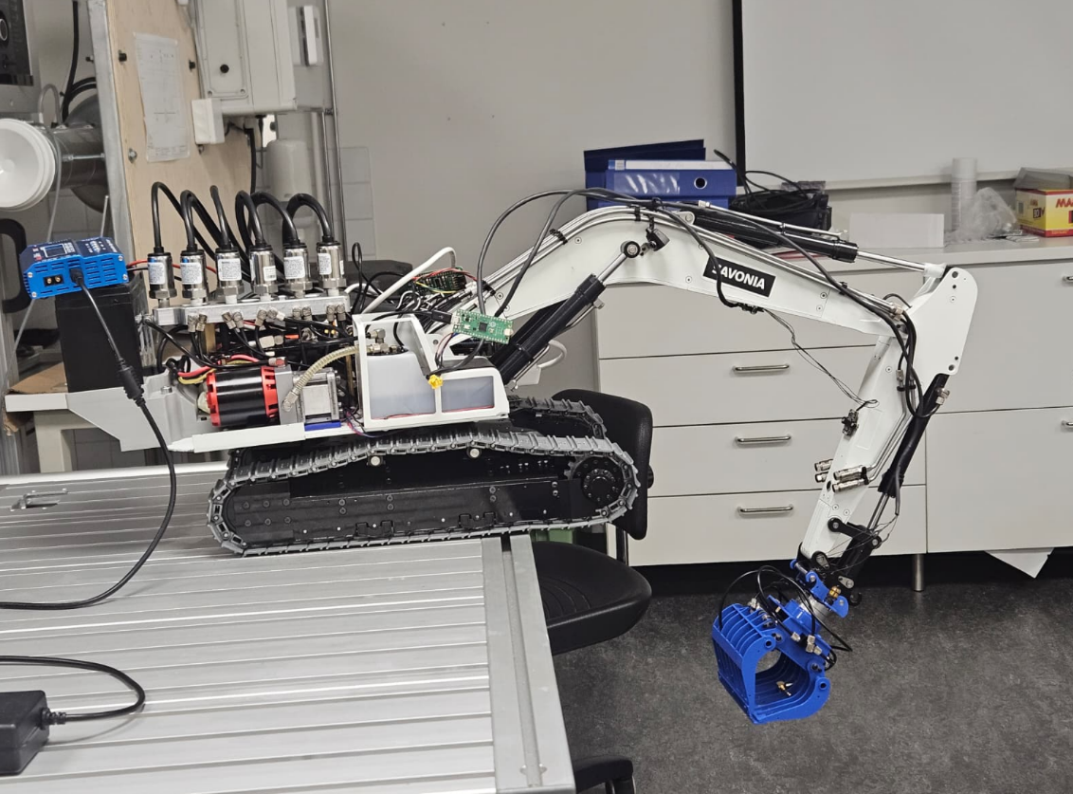
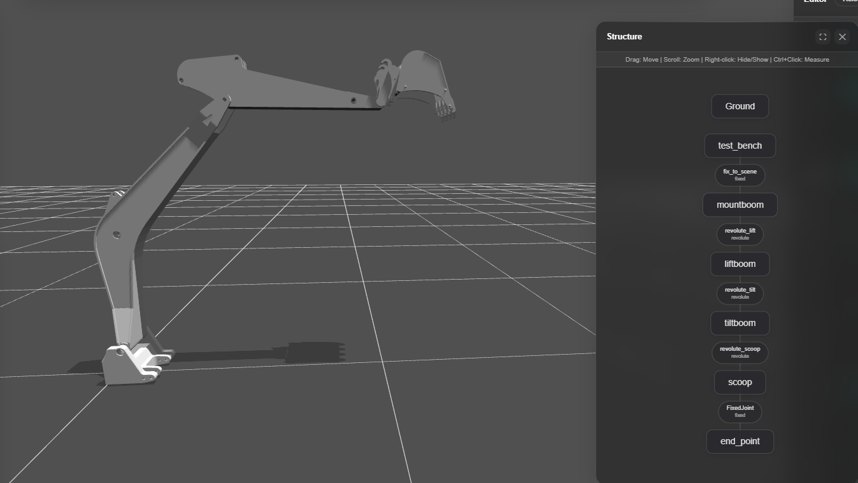

Slide 2
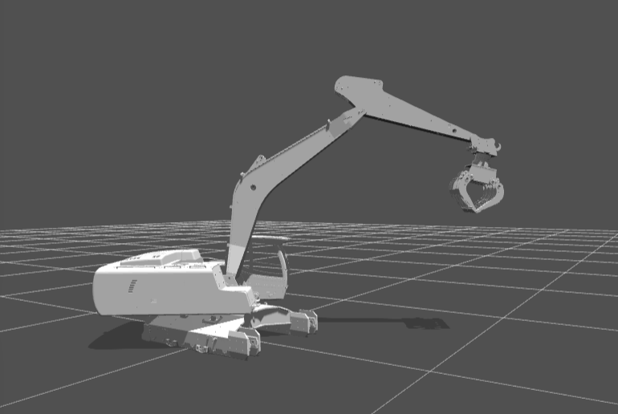
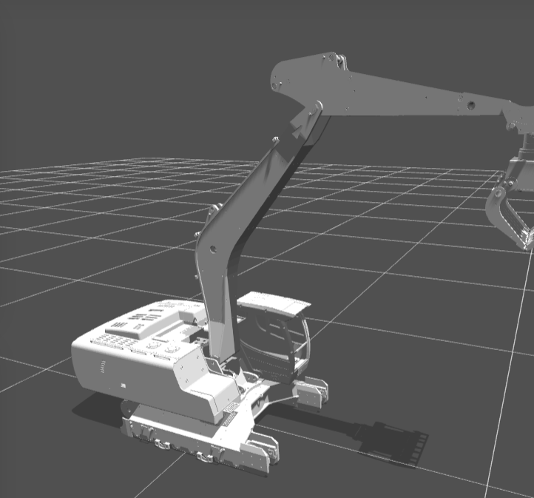
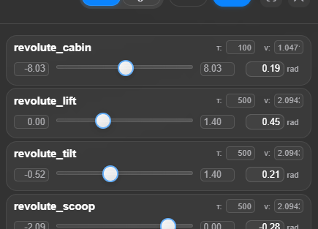
urdf align with real robot
https://viewer.robotsfan.com/

Slide 3
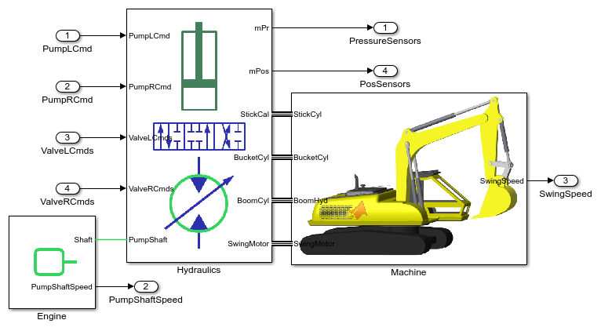

Slide 4
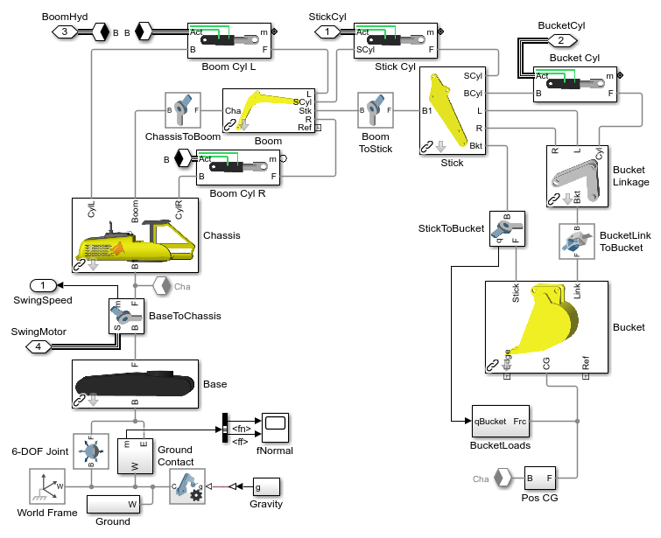










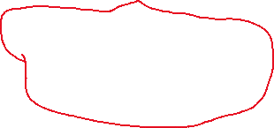

Slide 5
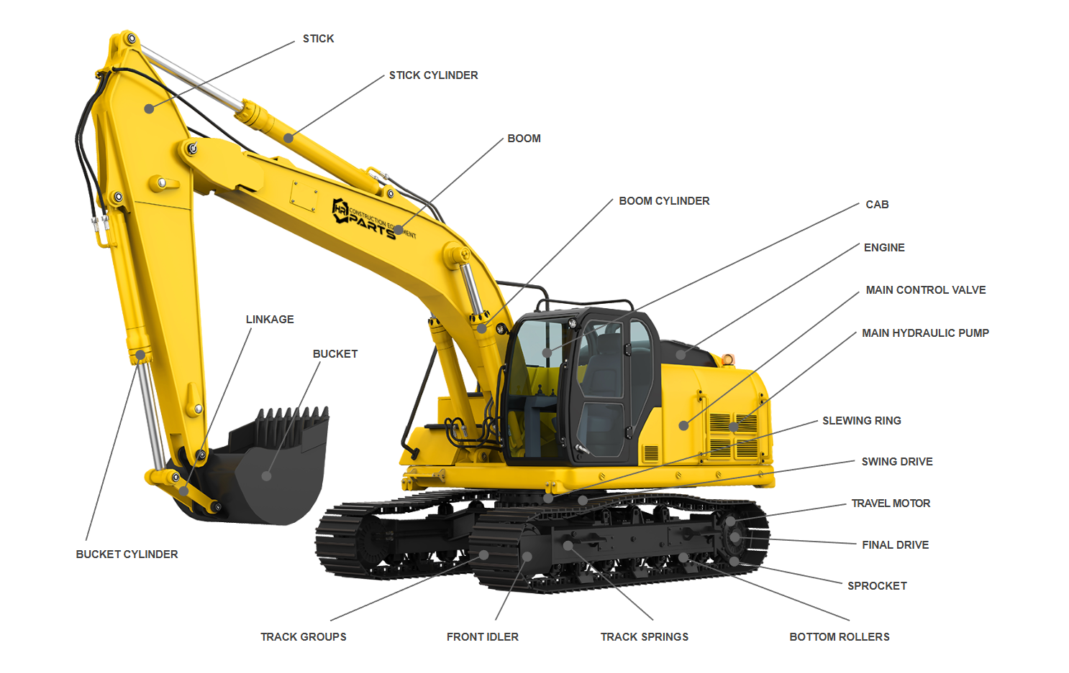
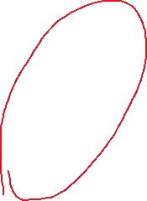
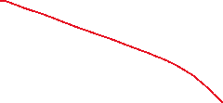

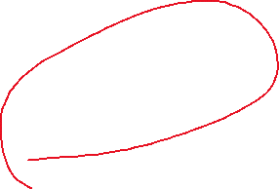
Notes:
https://www.hrparts.com/blog/post/excavator-parts-diagram-interactive?srsltid=AfmBOoow4UQrs_g9Zim_wBUuySZboLPSEy-IT9ZWmgwKT8euKwA0Q84t#bucket-cylinder-def

Slide 6
Model 1

Slide 8
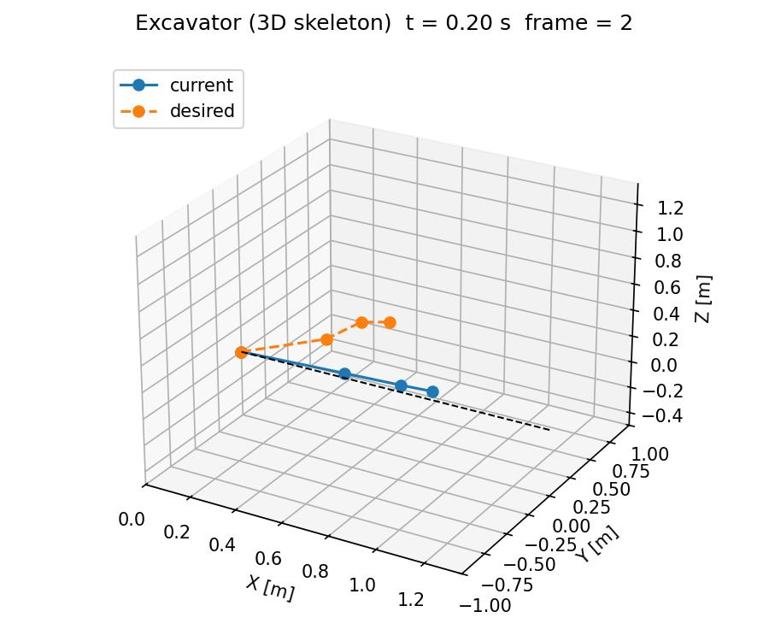
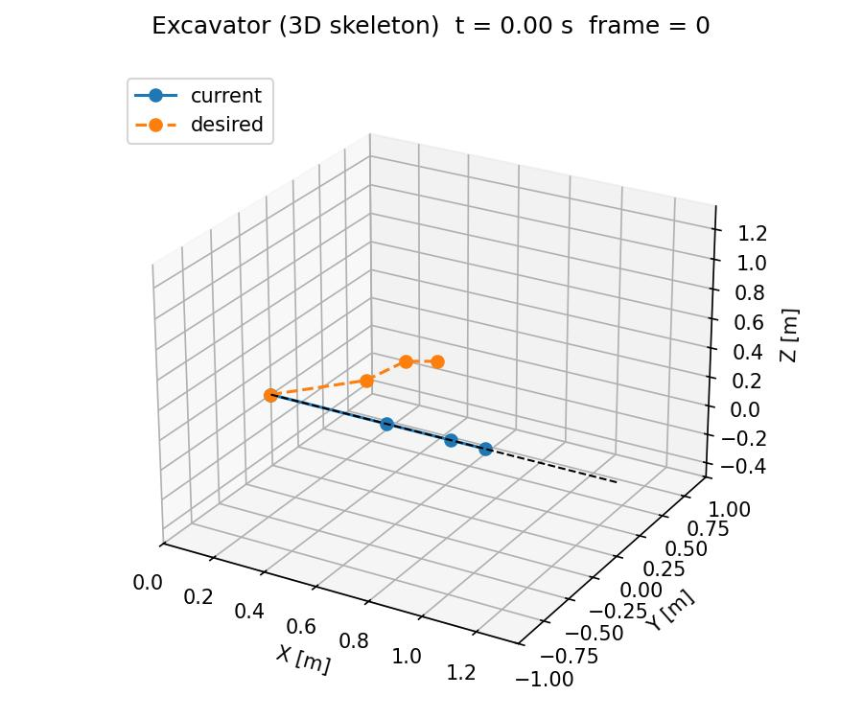



Slide 9
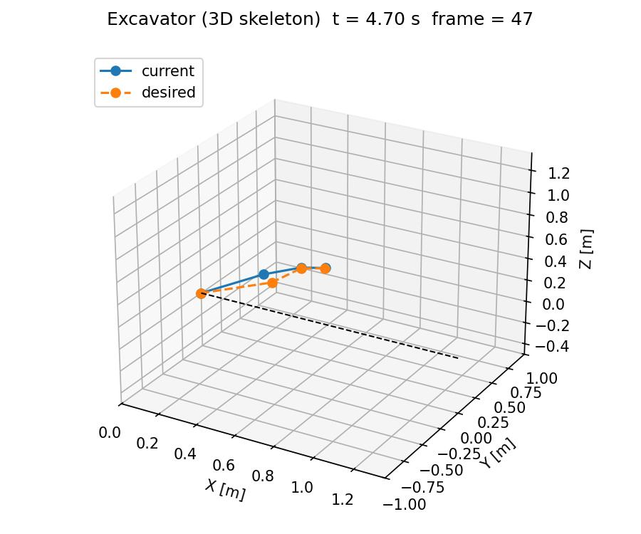




Slide 10
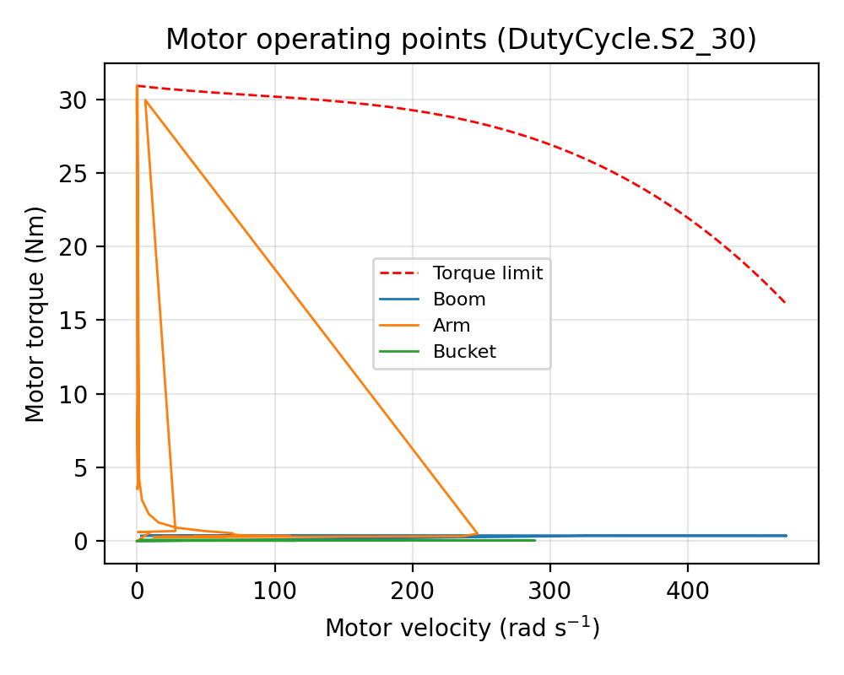
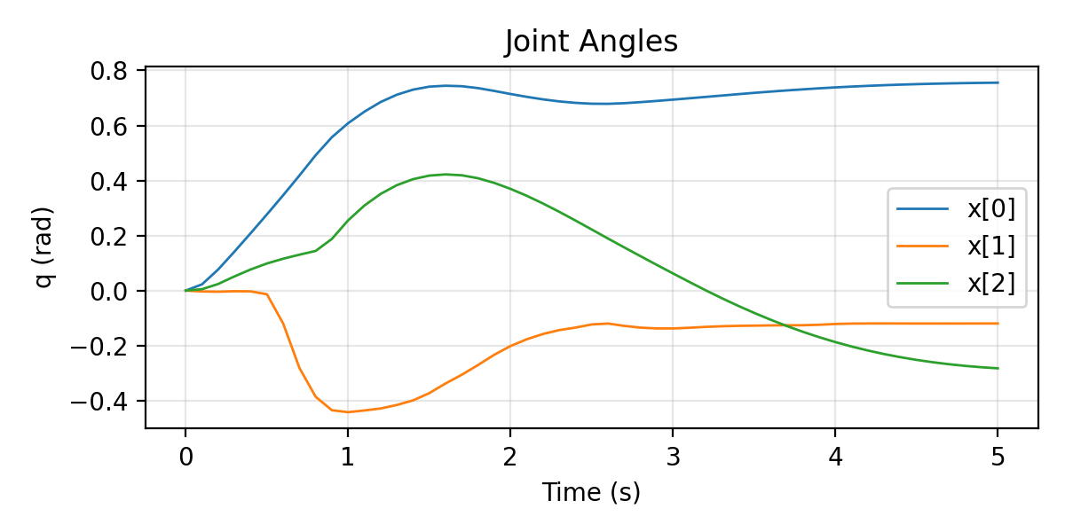
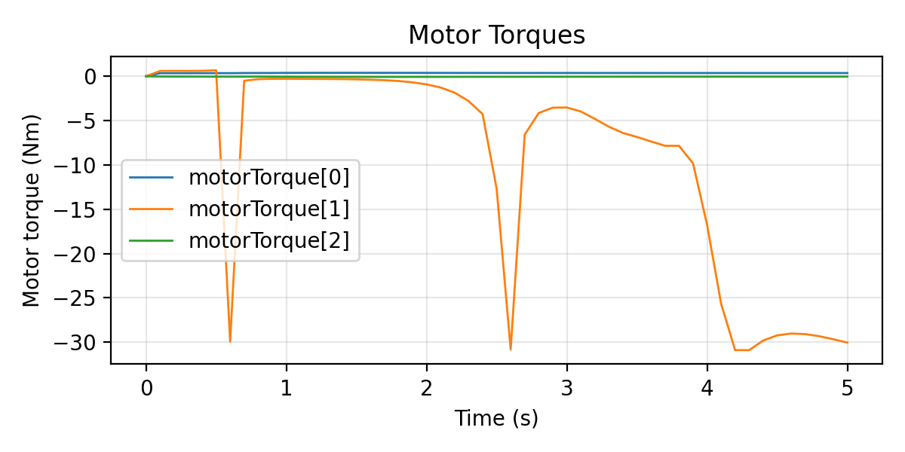
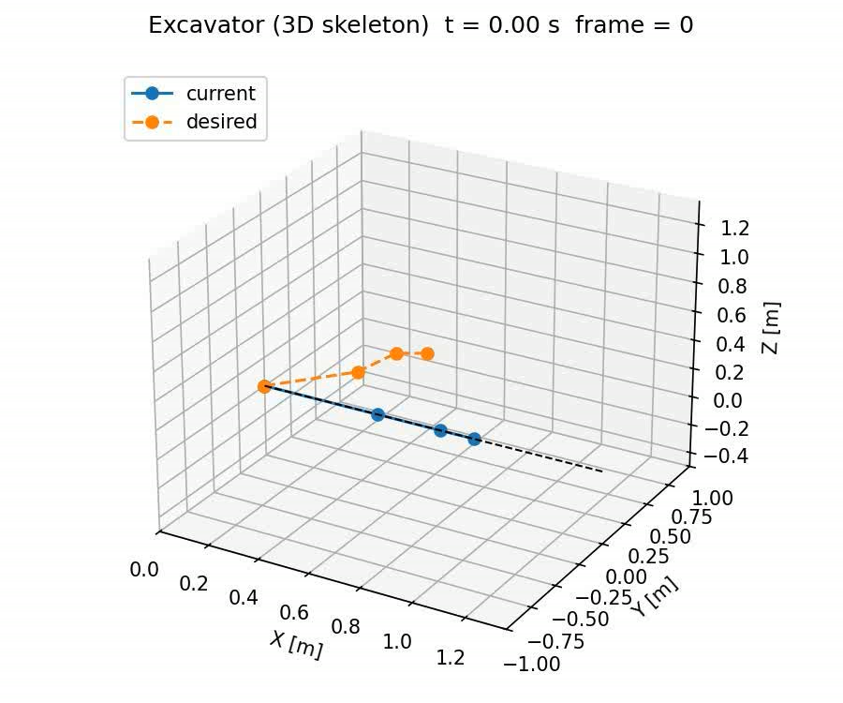
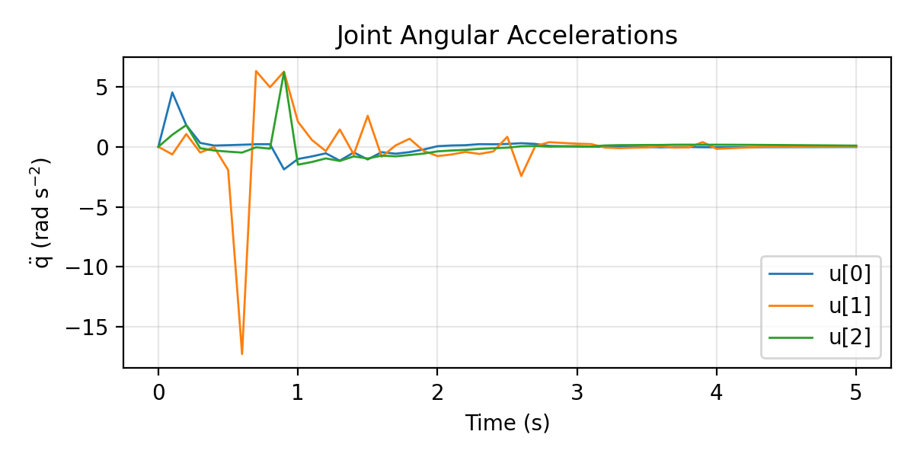
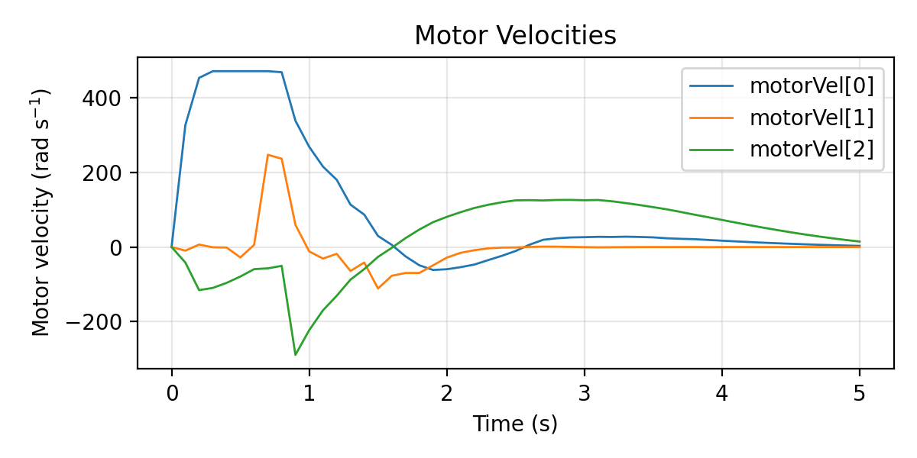

Slide 11
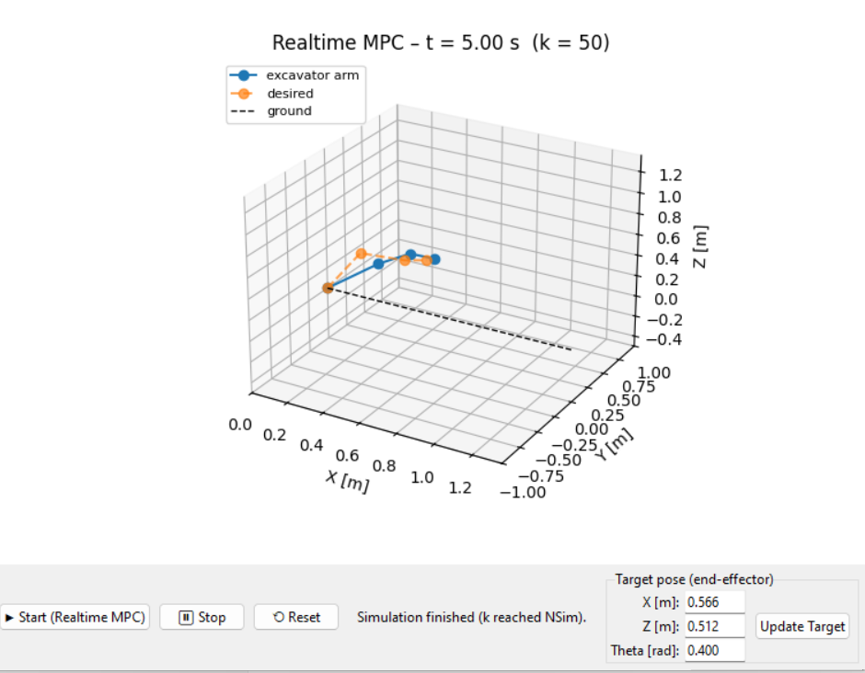
Test2 update the position

Slide 12
base ≈ test_bench（或者 test_bench + mountboom 这一块底座）
boom ≈ liftboom（第一节大臂，负责 lift）
arm ≈ tiltboom（第二节小臂，负责 tilt）
bucket ≈ scoop（铲斗）
tip ≈ end_point（末端点）
test_bench ──fix_to_scene──> mountboom
└─(revolute_lift)──> liftboom ← 对应原来的 boom 关节（jointBoom）
└─(revolute_tilt)──> tiltboom ← 对应原来的 arm 关节（jointArm）
└─(revolute_scoop)──> scoop ← 对应原来的 bucket 关节（jointBucket）
└─FixedJoint──> end_point ← 对应原来的 tip
<joint name="revolute_tilt" origin="0.20564 0 0.420085" parent="liftboom" child="tiltboom"/>
<joint name="revolute_scoop" origin="0.25 0 0" parent="tiltboom" child="scoop"/>

Slide 13
base yaw （when we get base, rotation fuc.）
How to build the model based MPc ,we need
1. a good plugins of algrithem for it
2.we need a perfect and precisise urdf can map the real robot architecture we have , like a mirror better real and virtual.
3. 3D rigid-body dynamics update

Slide 14
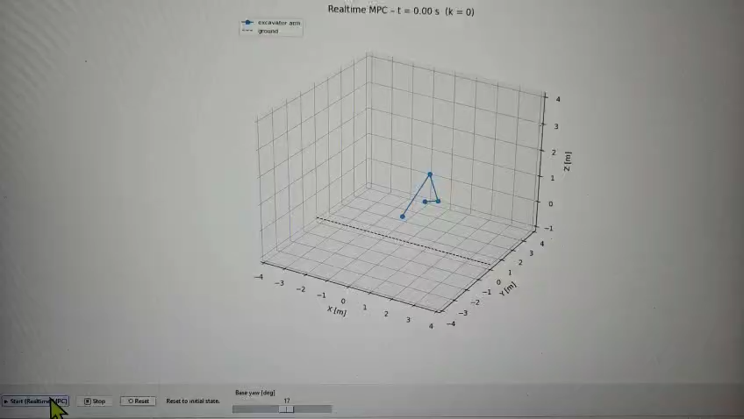
Test 1
1

Slide 15
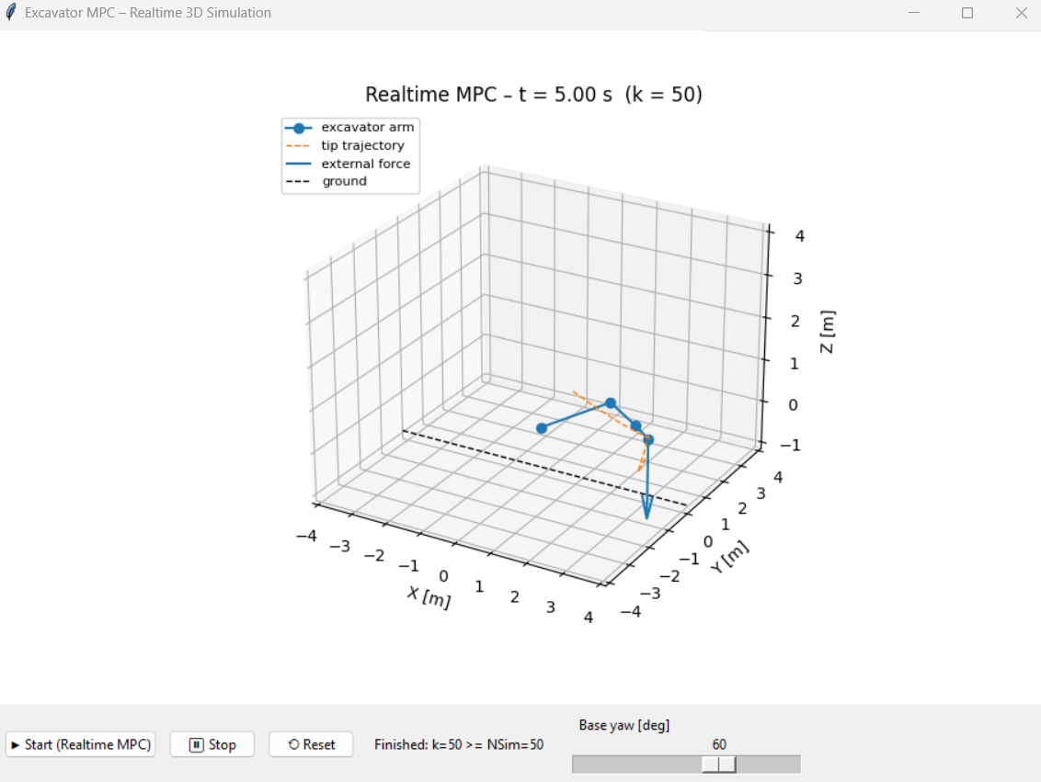
the terminal trajectory and external force arrows have been added
1

Slide 16
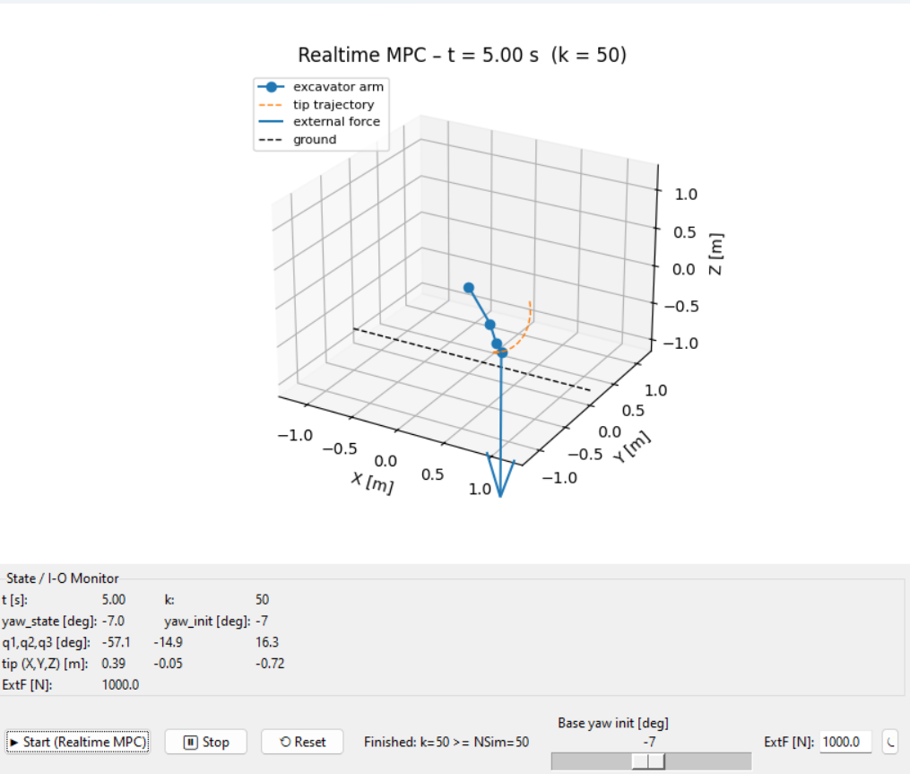
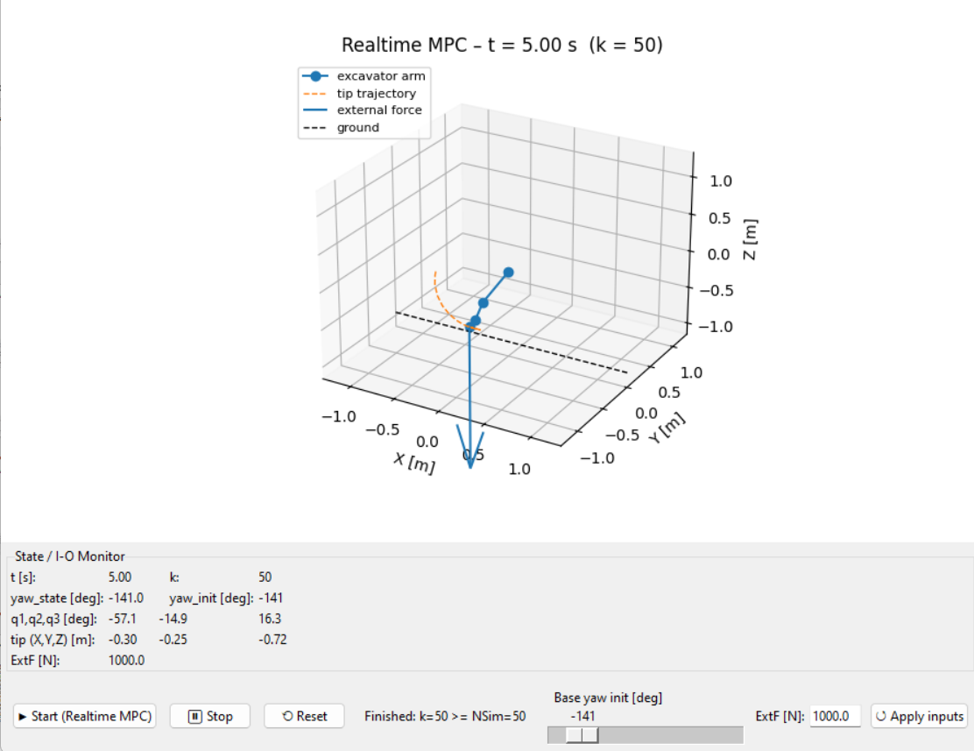
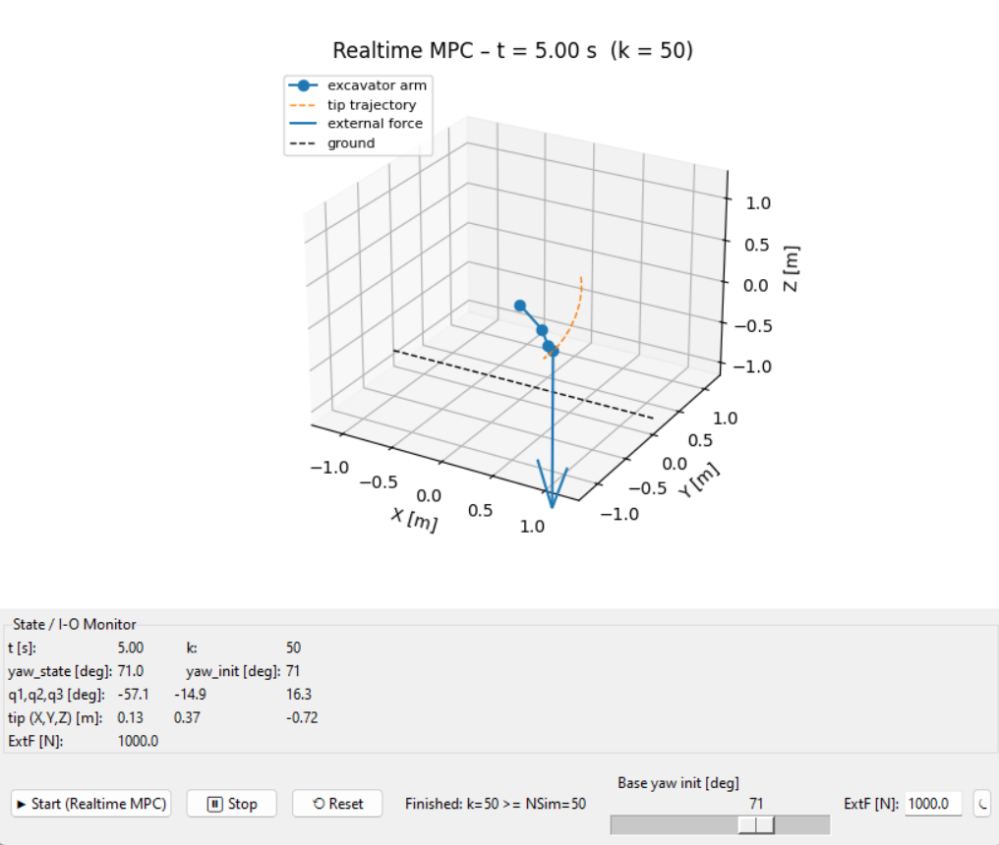
yaw_state new model
PS D:\thesis\excavater\code\eXactMPC_v1\Python> python .\mpc_realtime_gui.py
Segment lengths (URDF-based): 0.468 0.25 0.104

Slide 17
urdf align with real robot
https://viewer.robotsfan.com/

Slide 18
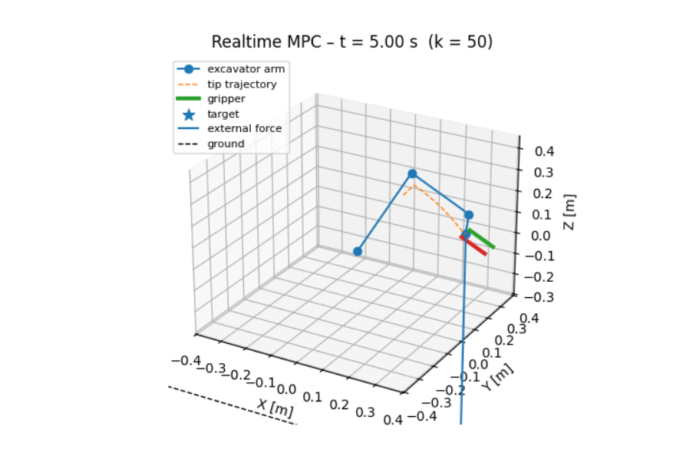
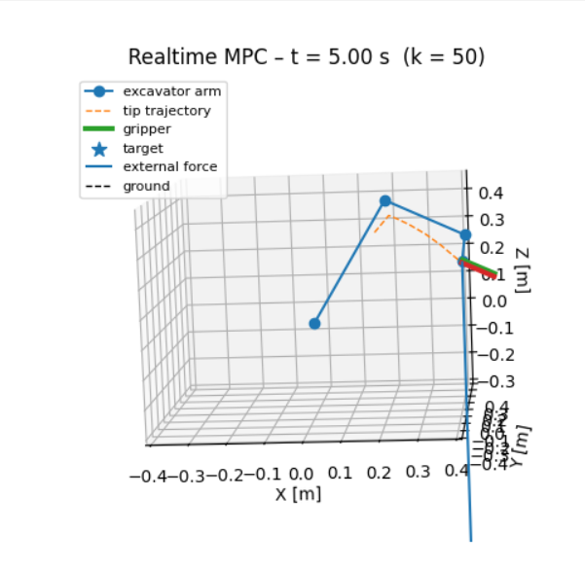

Slide 19
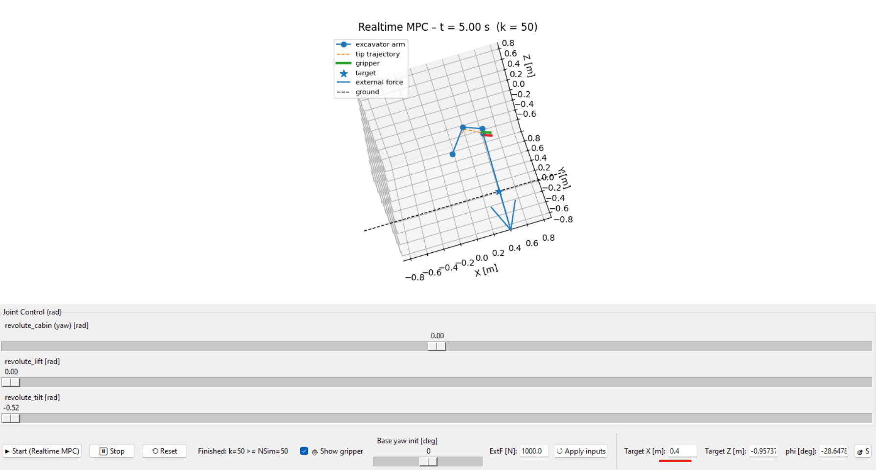
X, 0.4

Slide 20
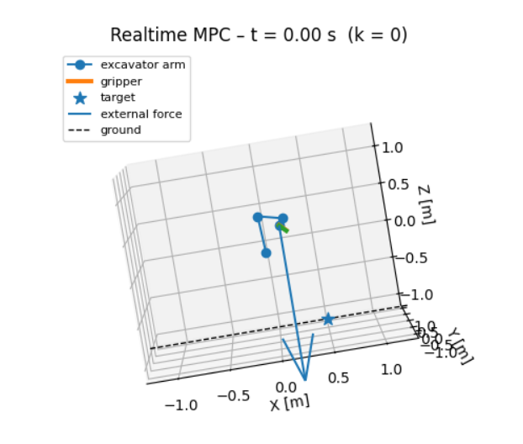
X, 0.5

Slide 21
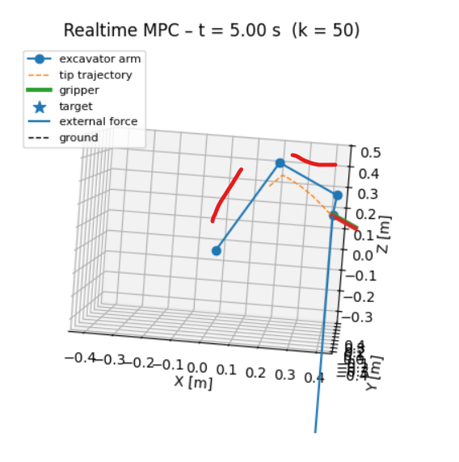
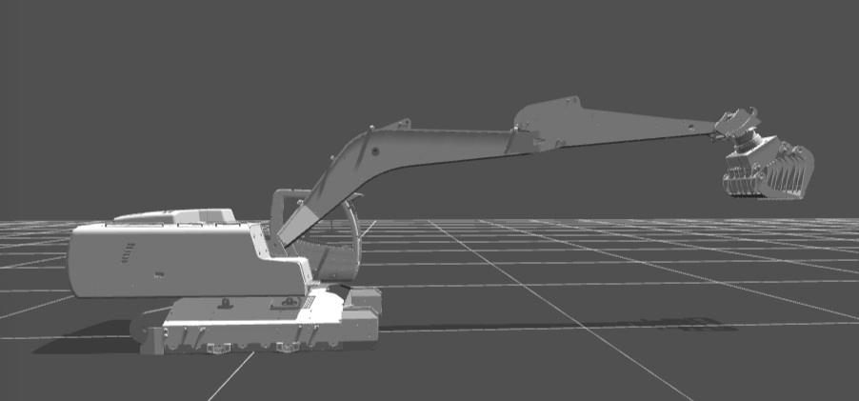
The URDF model allows the robotic arm to adopt a horizontal posture, as shown in the right-hand diagram. However, the current configuration on the left side is incapable of this. Restrictions must have been imposed somewhere, as this behaviour is otherwise implausible. Presently, the arm is unable to fully extend and remains in a contracted state.

Slide 22
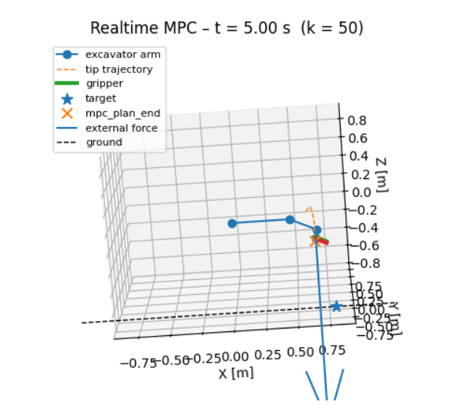
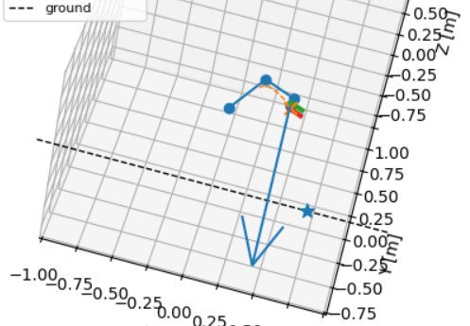
X, 0.7

Slide 23
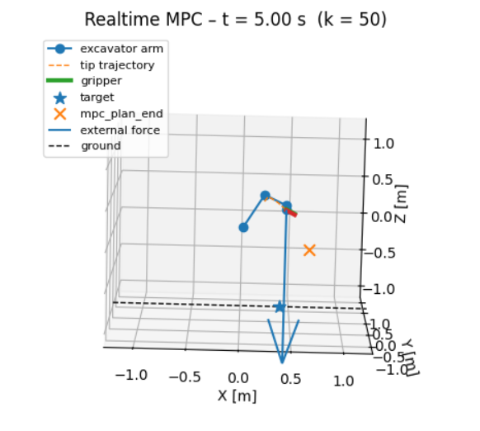
Issues 24.12.2025
python mpc_realtime_gui.py
[URDF] Loaded kinematics: L1=0.4677, L2=0.2497, OFF1=1.1156, OFF2=-0.0097, TCP=(0.0364,-0.0451), BASE=(0.0172,0.0630)
******************************************************************************
This program contains Ipopt, a library for large-scale nonlinear optimization.
Ipopt is released as open source code under the Eclipse Public License (EPL).
For more information visit https://github.com/coin-or/Ipopt
******************************************************************************
=== NLP solve failed, using debug solution ===
Error in Opti::solve [OptiNode] at .../casadi/core/optistack.cpp:217:
.../casadi/core/optistack_internal.cpp:1338: Assertion "return_success(accept_limit)" failed:
Solver failed. You may use opti.debug.value to investigate the latest values of variables. return_status is 'Infeasible_Problem_Detected'

Slide 24
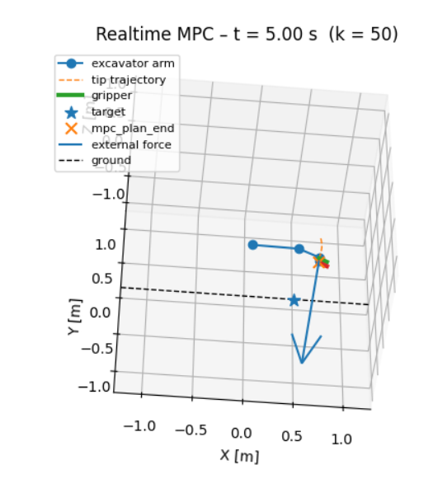
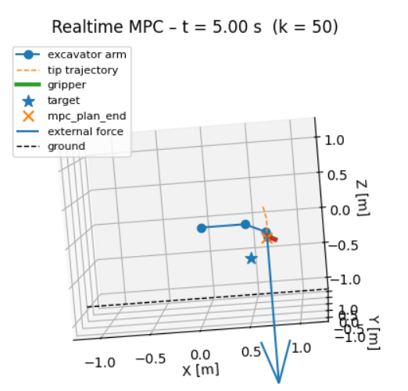
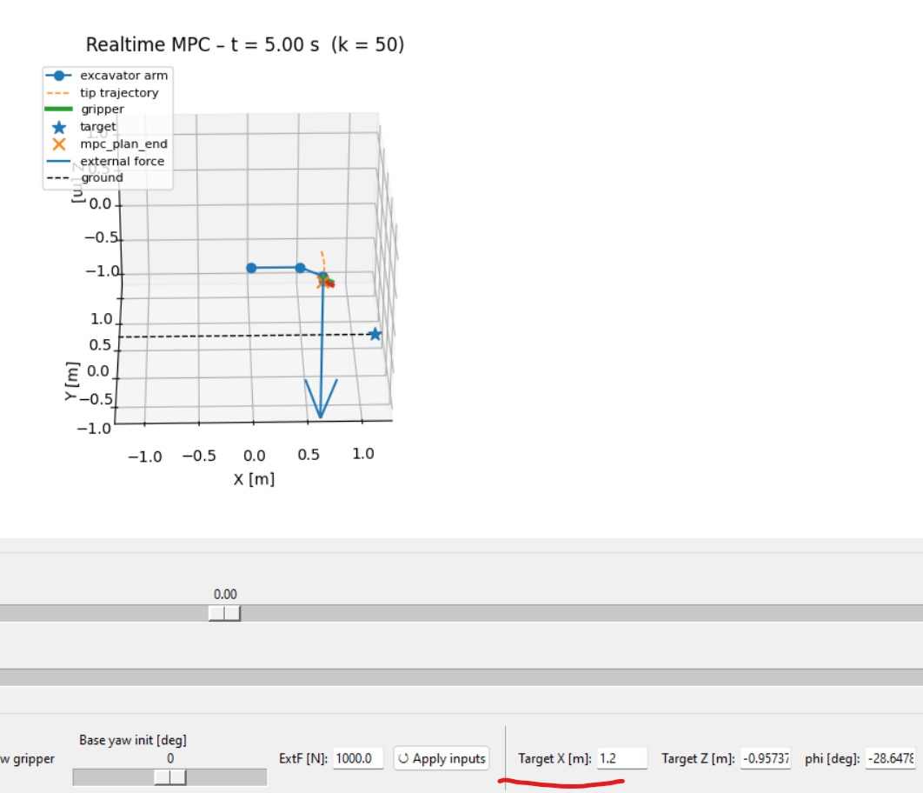

Slide 25
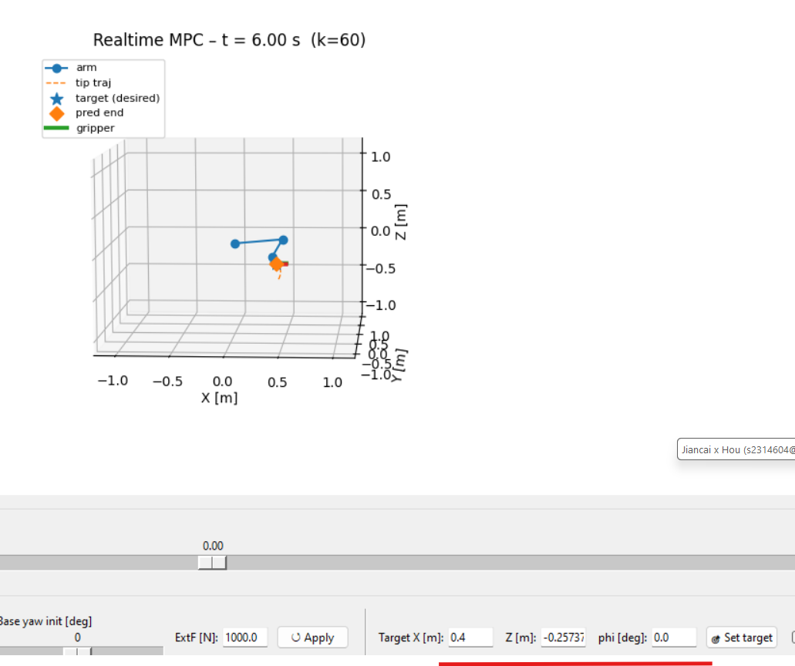
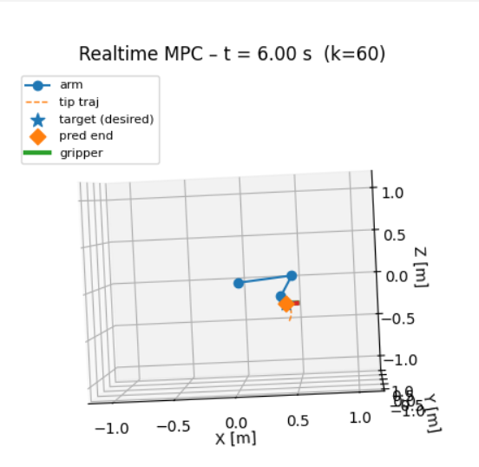
Success case 24.12.2025
x=0.70, z=yGround, phi=0

Slide 26
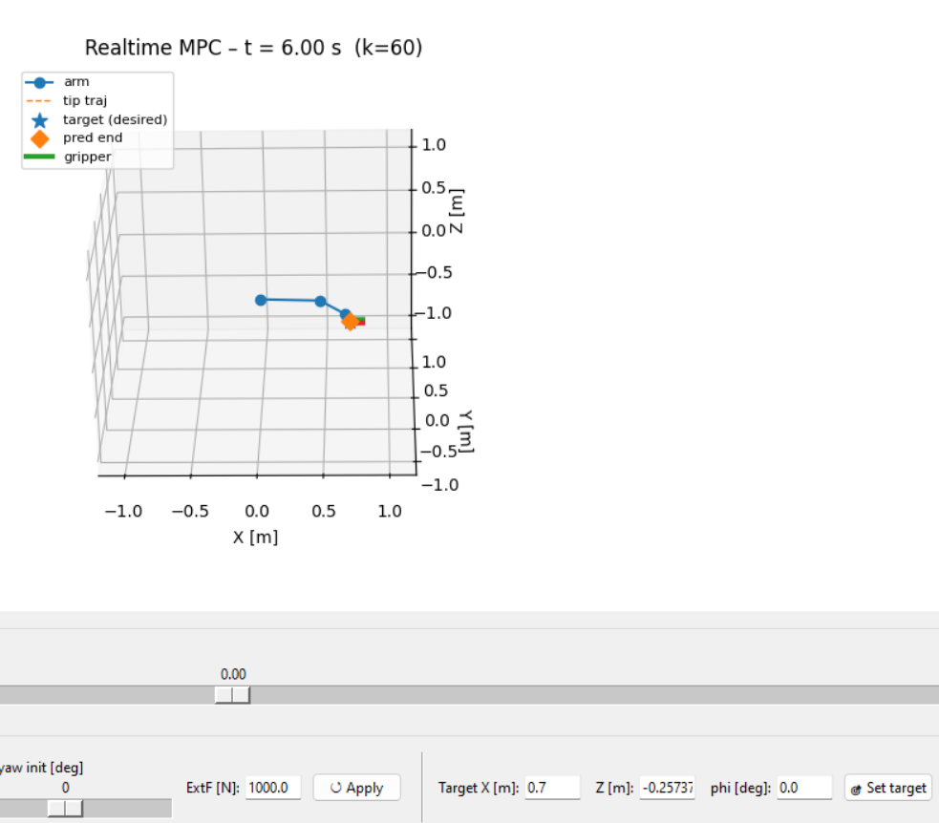
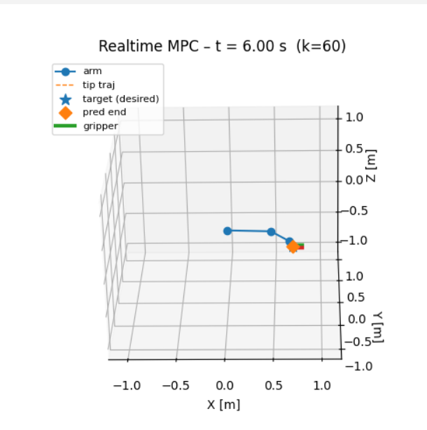
Success case 24.12.2025 0.

Slide 27
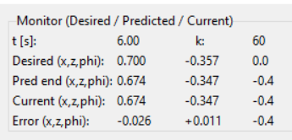
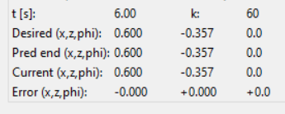
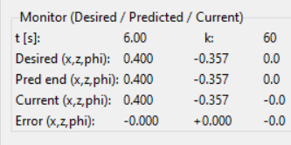
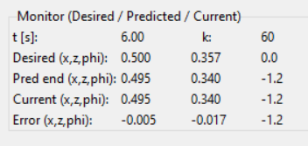
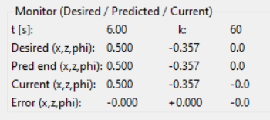
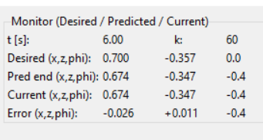

Slide 28
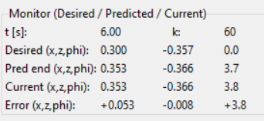

Slide 29



limited: 0.3

Slide 30



Slide 31
Next step
Potential upgrade directions (depending on your thesis/project requirements):
Add a separate yaw objective to the cost function:
For instance, to align the excavator's final yaw with a specific direction, incorporate:
Qψ​(ψ−ψdes​)2
Fully integrate external forces extF into the model:
For example:
Simply introduce an equivalent load in the dynamics;
Alternatively, incorporate an ‘external force resistance’ term into the cost function to compare MPC behaviour with and without external forces.
Record time series:
Store yaw, q1–q3, and tip trajectories in arrays, then plot 2D graphs (e.g., yaw vs. time, tip XY projections) for easier paper/report writing.
Should you decide which aspect to tackle next (e.g., ‘adding a desired trajectory for yaw’ or ‘incorporating extF into the OCP model’), simply let me know. I can modify the corresponding code segments based on your current operational framework.

Slide 32

Label | Part | Location | X(m) | Y(m)
A1 | Chassis | Boom | 0.00000 | 0.05300
A2 | Chassis | Boom Cylinder | 0.06800 | 0.03600
B1 | Boom | Boom Cylinder | 0.12600 | 0.27100
B2 | Boom | Stick Cylinder | 0.13500 | 0.31000
B3 | Boom | Stick | 0.42800 | 0.24200
C1 | Stick | Stick Cylinder | 0.42500 | 0.32000
C2 | Stick | Bucket Cylinder | 0.48400 | 0.27300
C3 | Stick | Linkage | 0.54300 | 0.12000
C4 | Stick | Bucket | 0.57000 | 0.07000
E1 | Linkage | Bucket Cylinder | 0.60200 | 0.15300
D1 | Bucket | Linkage | 0.61100 | 0.10100
D2 | Bucket | Cutting Edge | 0.62700 | -0.06700
D3 | Bucket | CG | 0.62700 | -0.06700

Slide 33
outline
Topic
Goals
Plans
Study resource/ code

Slide 34
Thesis topic
Simulation-based development for a nonlinear excavator system
(with emphasis on practical feasibility and flexible model choice)

Slide 35
Research Goals
1.Use provided excavator model or similar excavator model from open resource to build environment
2. model-based learning model or reinforcement learning model
3.generate a simulation demo for illustrative tasks (such as log lifting or trajectory tracking).
4.optionally implement and compare different control strategies on simulator environment, such as MPC vs PID;

Slide 36
Phase | Main tasks | Timeframe (08.12.2025~1.02.2026)
Planning | Finalise topic, agree responsibilities, write and approve work plan (including analysing the feasibility) | Month 1(December)
Simulation setup | Integrate excavator model, implement dynamics, set up training environment. | Month 1(December)
Controller implementation | Implement a Baseline controller or MPC or learning-based controllers on simulation environment | Month 2(January)
Experiments and analysis | Run simulations, collect data, evaluate performance | Month 2(January)
Writing and finalisation | Write results, discussion, conclusions, revise with supervisor | Month 3(February)

Slide 37


study cases
https://github.com/simscape/Excavator-Simscape
https://github.com/xuexianlim/eXactMPC

Slide 38


https://github.com/mathworks-robotics/autonomous-excavator
https://github.com/leggedrobotics/rsl_heap

Slide 39


http://bilibili.com/video/BV1jG4y1h7KU/?vd_source=d039de0562f9406b58c45a447595a8b6
# other models
https://github.com/eyhxh/3Dprint-mini-RC-excavator
https://github.com/swholmstead/Excavator

Slide 40
https://github.com/omni-mcp/isaac-sim-mcp/tree/main
Natural language control of Isaac Sim
Dynamic robot positioning and movement
Custom lighting and scene creation
Advanced robot simulations with obstacle navigation
Interactive code preview before execution
https://github.com/fiveages-sim/arms_ros2_control

Slide 41
https://github.com/BruceShaw0923/Dual-Arm-Robot-MPC-Simulation?tab=readme-ov-file
simple
https://github.com/NVlabs/curobo
https://github.com/omni-mcp/isaac-sim-mcp
https://viewer.robotsfan.com/

Slide 42
Thanks

